Slide 1
“Evolutionary feature selection for machine learning based malware classification”
Authors: Gulsade Kale, Gazi Erkan Bostanci, Fatih Vehbi Celebi
Slides by: Devere Anthony Weaver

Slide 2
Sections
Abstract
Introduction
Theoretical Background
Proposed Approach
Experimental Results
Conclusion
Future Work

Slide 3
Abstract
“The aim of this paper is to identify the optimal feature selection and classification methods yielding the highest accuracy within the Cuckoo Sandbox environment”

Slide 4
Introduction
“Based on projections…cybercrime will escalate to $9.5 trillion USD in 2024…escalating financial toll stemming from cybercrime-induced damages is forecasted to elevate to $10.5 trillion by the year 2025.”
Traditional malware analysis techniques are cumbersome, so let’s try ML
Assumption: Feature selection can significantly decrease the superfluous and inconsequential features within the initial extensive feature space.
Improved detection rate
Reduce feature space
Increase malware detection processing time

Slide 5
Introduction
Multiobjective evolutionary algorithm (MOEA) Framework employed for the implementation of Genetic Algorithms (GA).
Optimization techniques to find a set of solutions involving multiple conflicting objectives; no single optimal solution exists
Algorithms used
Decomposition-Based Evolutionary Algorithm (DBEA)
Pareto Archived Evolution Strategy (PAES)
Reactive Search Optimization (RSO)
Simple random algorithm (RANDOM)
Etc.
Related Work

Slide 6
Theoretical Background
See COSC670 slides for recap
Malware and Its Taxonomy
Types of malware (virus, worm, trojan, backdoor, adware, downloader, dropper, keylogger, ransomware, etc.)
Malware Detection Techniques
Signature-based analysis
Anomaly-based analysis
Specification-based analysis (high false positives)
Static analysis
Dynamic analysis

Slide 7
Theoretical Background
Machine Learning methods
Feature extraction
Feature selection
Supervised vs. Unsupervised Learning
Classification
Genetic Algorithms

Slide 8
Proposed Approach
Implementation
Set up lab environment with modified Cuckoo Sandbox
Input: Malicious files
Output: JSON report
Extract relevant features
Input: JSON report
Output: CSV file w/335 attributes and 1 class
Selecting effectual features (traditional feature selection vs. multiobjective genetic algorithm)
Used GAs to generate features
PAES algorithm was optimal and reduced to 200 features (-135 features)
Implement ML methods
Algorithms: J48, AdaBoostM1, Rep Tree, Multilayer Perceptron, Naïve Bayes
70/30 train/test split

Slide 9
Experimental Results
Metrics used
Kappa
Mean Absolute Error (MAE)
Root Mean Square Error (RMSE)
False Positive Rate (FP)
Precision
Recall
F-Measure
Accuracy

Slide 10
Experimental Results
Them: Using GAs improved certain metrics for some algorithms; no improvement for others.
Me: Marginal improvements and somewhat expected.

Slide 11
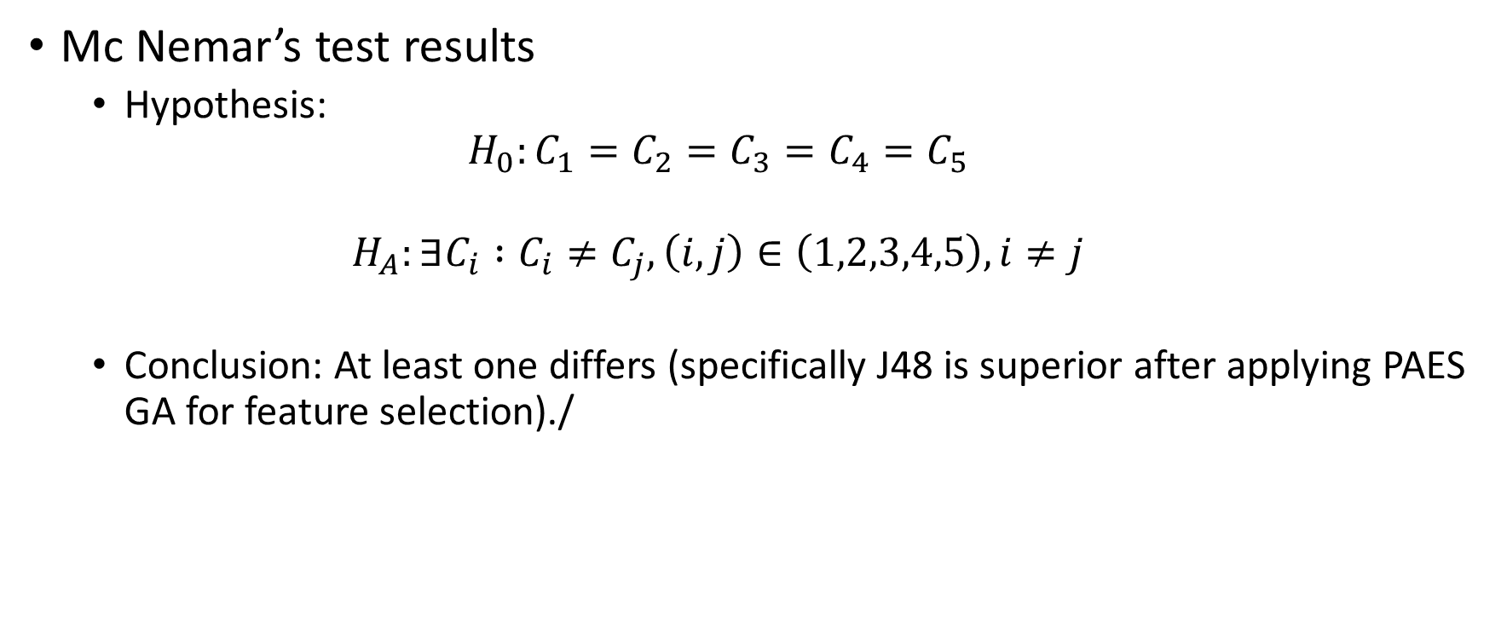
Experimental Results
Mc Nemar’s test results
Hypothesis:
$$H_{0}:C_{1}=C_{2}=C_{3}=C_{4}=C_{5}$$
$$H_{A}:∃C_{i} :C_{i}≠C_{j}, \left(i,j\right)∈\left(1,2,3,4,5\right), i≠j$$
Conclusion: At least one differs (specifically J48 is superior after applying PAES GA for feature selection)./

Slide 12
Conclusion
GA for feature selection showed improvements over traditional methods for feature selection.
Number of features reduced
Accuracy and other metrics increased

Slide 13
Future Work
Add more malware and benign samples to data set.

Slide 14
References
G. Kale, G. E. Bostancı, and F. V. Çelebi, “Evolutionary feature selection for machine learning based malware classification,” Engineering Science and Technology, an International Journal, vol. 56, p. 101762, Aug. 2024, doi: 10.1016/j.jestch.2024.101762.

